Slide 1

Working with databases: SQL querries
Marcin Skurczyński
Introduction to Programming for Business

Slide 2
How the software works with data?
Hardware
Software
User’s input
Software’s response
Data
HDD
On-Line
…
User’s data

Slide 3
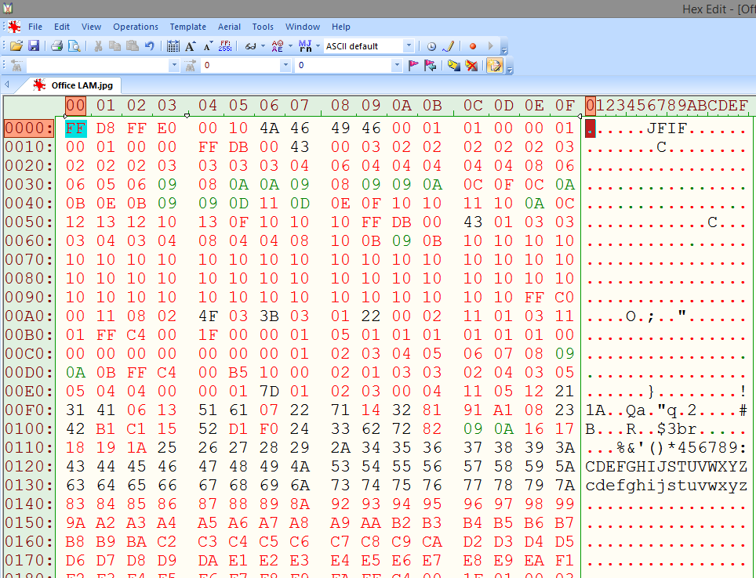
How to store data?
Memory
Files (HDD, SSD, FTP…)
Databases

Slide 4
What is a database?
„A collection of pieces of information that is organized and used on a computer.”
http://www.merriam-webster.com/
„A database is a collection of information that is organized so that it can easily be accessed, managed, and updated. In one view, databases can be classified according to types of content: bibliographic, full-text, numeric, and images.”
http://searchsqlserver.techtarget.com/

Slide 5






Examples of databases

Slide 6
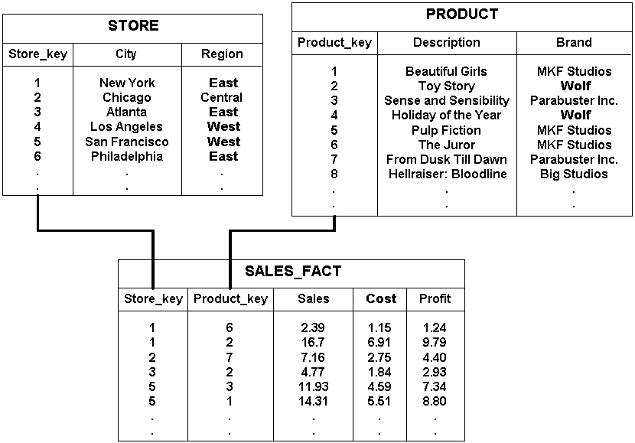
How does it look?
http://docs.oracle.com/

Slide 7
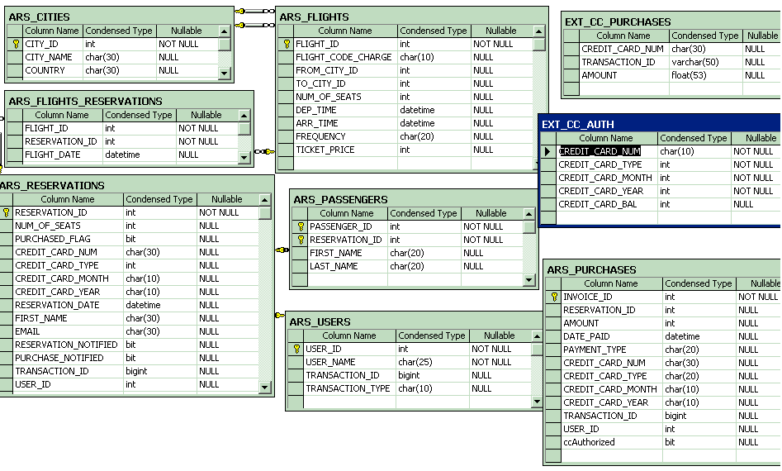
Tables and data types
http://www.ece.cmu.edu/

Slide 8
Data types
Text types:
Number types:
Data type | Description
CHAR(size) | Holds a fixed length string (can contain letters, numbers, and special characters). The fixed size is specified in parenthesis. Can store up to 255 characters
VARCHAR(size) | Holds a variable length string (can contain letters, numbers, and special characters). The maximum size is specified in parenthesis. Can store up to 255 characters. Note: If you put a greater value than 255 it will be converted to a TEXT type
TINYTEXT | Holds a string with a maximum length of 255 characters
TEXT | Holds a string with a maximum length of 65,535 characters
BLOB | For BLOBs (Binary Large OBjects). Holds up to 65,535 bytes of data
MEDIUMTEXT | Holds a string with a maximum length of 16,777,215 characters
MEDIUMBLOB | For BLOBs (Binary Large OBjects). Holds up to 16,777,215 bytes of data
LONGTEXT | Holds a string with a maximum length of 4,294,967,295 characters
LONGBLOB | For BLOBs (Binary Large OBjects). Holds up to 4,294,967,295 bytes of data
ENUM(x,y,z,etc.) | Let you enter a list of possible values. You can list up to 65535 values in an ENUM list. If a value is inserted that is not in the list, a blank value will be inserted.Note: The values are sorted in the order you enter them. You enter the possible values in this format: ENUM('X','Y','Z')
SET | Similar to ENUM except that SET may contain up to 64 list items and can store more than one choice
Data type | Description
TINYINT(size) | -128 to 127 normal. 0 to 255 UNSIGNED*. The maximum number of digits may be specified in parenthesis
SMALLINT(size) | -32768 to 32767 normal. 0 to 65535 UNSIGNED*. The maximum number of digits may be specified in parenthesis
MEDIUMINT(size) | -8388608 to 8388607 normal. 0 to 16777215 UNSIGNED*. The maximum number of digits may be specified in parenthesis
INT(size) | -2147483648 to 2147483647 normal. 0 to 4294967295 UNSIGNED*. The maximum number of digits may be specified in parenthesis
BIGINT(size) | -9223372036854775808 to 9223372036854775807 normal. 0 to 18446744073709551615 UNSIGNED*. The maximum number of digits may be specified in parenthesis
FLOAT(size,d) | A small number with a floating decimal point. The maximum number of digits may be specified in the size parameter. The maximum number of digits to the right of the decimal point is specified in the d parameter
DOUBLE(size,d) | A large number with a floating decimal point. The maximum number of digits may be specified in the size parameter. The maximum number of digits to the right of the decimal point is specified in the d parameter
DECIMAL(size,d) | A DOUBLE stored as a string , allowing for a fixed decimal point. The maximum number of digits may be specified in the size parameter. The maximum number of digits to the right of the decimal point is specified in the d parameter

Slide 9
What can you ask about?
How many customers do we have from Mexico?
What is an avarage age of our employees?
How many orders have we processed in 1997?
Which of our suppliers come from Germany?
Which customer placed the most orders?
What is the date of the last order?

Slide 10
Basic syntax
Function saying what to do.
Also: DELETE, UPDATE, INSERT
Function saying where to search for data.
SELECT … FROM …
Here go fields to retrieve
Here goes table name

Slide 11
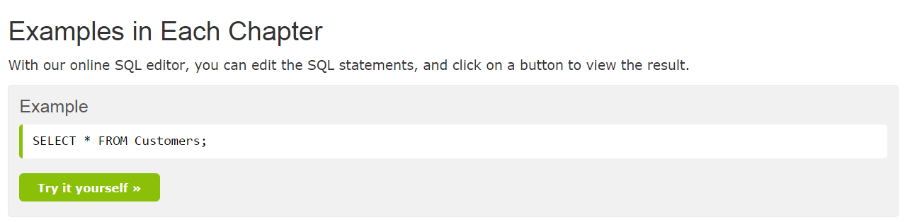
Try it:
http://www.w3schools.com/sql/

Slide 12
Filtering: WHERE clause
SELECT … FROM … WHERE [here comes the logic…]
WHERE examples:
… NameColumn = `Marcin`
… NameColumn LIKE `%M%’
… IdNo > 200

Slide 13
Grouping variables
Example Table:
Col0: sale_id
Col1: salesman
Col2: sales
Col3: sales
SELECT salesman, SUM(sales), COUNT(sales)
FROM SalesTable
GROUP BY salesman

Slide 14
Connecting multiple tables
SELECT A.ContactName, B.*
FROM Customers A, Orders B
WHERE A.CustomerID = B.CustomerID
ORDER BY A.ContactName

Slide 15
Tasks:
Show all elements in the table
Select people living in Germany
Show orders with quantity greater than 10
Connect customers & orders. Show quantity per customer
Group orders by country. How many items went to Germany?

